Slide 1
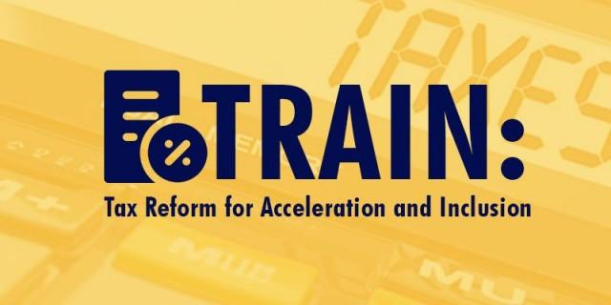

Slide 3
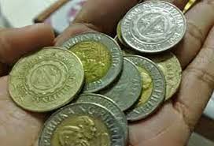
Lowering the personal income tax (PIT)
TRAIN will lower personal income tax (PIT) for all taxpayers except the richest.
Those with taxable income below P250,000 will be exempt from paying PIT, while the rest of taxpayers, except the richest, will see lower tax rates ranging from 15% to 25% by 2020.
The personal income tax system of TRAIN will exempt some 83% of current taxpayers.

Slide 4
Lowering the personal income tax (PIT)
Upon implementation of TRAIN (2018-2020)
Annual taxable income Tax rate | Tax rate
0 - 250,000 | 0%
Over 250,000 - 400,000 | 20% of the excess over 250,000
Over 400,000 - 800,000 | 30,000 + 25% of the excess over 400,000
Over 800,000 - 2,000,000 | 130,000 + 30% of the excess over 800,000
Over 2,000,000 - 5,000,000 | 490,000 + 32% of the excess over 2,000,000
Over 5,000,000 | 1,450,000 + 35% of the excess over 5,000,000

Slide 5
Lowering the personal income tax (PIT)
2021 onwards
Annual taxable income Tax rate | Tax rate
0 - 250,000 | 0%
Over 250,000 - 400,000 | 15% of the excess over 250,000
Over 400,000 - 800,000 | 22,500 + 20% of the excess over 400,000
Over 800,000 - 2,000,000 | 102,500 + 25% of the excess over 800,000
Over 2,000,000 - 5,000,000 | 402,500 + 30% of the excess over 2,000,000
Over 5,000,000 | 1,302,500 + 35% of the excess over 5,000,000

Slide 6
Lowering the personal income tax (PIT)

Slide 7
Lowering the personal income tax (PIT)

Slide 8
Simplifying the estate and donor's tax
In the current system, the tax rates can reach up to 20% of the net estate value and up to 15% on net donations. TRAIN seeks to simplify this. Estate and donor’s tax will be lowered and harmonized so it does not matter if the person passed away, donated a property, or simply wants to transfer a property. This will result in loss revenues but the key here is to make the land market more efficient so that the land will go to its best use.
Estate Tax - Instead of having a complicated tax schedule with different rates, TRAIN reduces and restructures the estate tax to a low and single tax rate of 6% based on the net value of the estate with a standard deduction of P5 million and exemption for the first P10 million for the family home.
Donor Tax - TRAIN also simplifies the payment of donor’s taxes to a single tax rate of 6% of net donations is imposed for gifts above P250,000 yearly regardless of relationship to the donor.

Slide 9
Expanding the Value-Added Tax (VAT) base
The Philippines has one of the highest VAT rates but also the highest number of exemptions in the Southeast Asia region.
These tax exemptions have created much confusion, complexity, and discretion in our tax system resulting in leakages and opening doors for negotiation, corruption, and tax evasion.
TRAIN aims to clean up the VAT system to make it fairer and simpler and lower the cost of compliance for both the taxpayers and tax administrators.
This is achieved by limiting VAT exemptions to necessities such as raw agriculture food, education, and health. This does not mean that the benefits the poor rightly deserve will be removed.
The TRAIN will direct the way to protect the poor and vulnerable compared to the tax exemptions and blind subsidies that are inefficient and largely beneficial to the rich since they have higher purchasing power.

Slide 10
Expanding the Value-Added Tax (VAT) base
TRAIN repeals 54 out of 61 special laws with non-essential VAT exemptions, thereby making the system fairer.
Purchases of senior citizens and persons with disabilities, however, will continue to be exempt from VAT.
Housing that cost below P2 million will be exempt from VAT beginning 2021
Medicines for diabetes, high cholesterol, and hypertension will be exempt beginning 2019.
The reform also aims to limit the VAT zero-rating to direct exporters who actually export goods out of the country. This will be implemented together with an enhanced VAT refund system that will provide timely cash refunds to exporters.

Slide 11
Expanding the Value-Added Tax (VAT) base
The VAT threshold is increased from P1.9 million to P3 million to protect the poor and low-income Filipinos and small and micro businesses and for manageable administration. This effectively exempts the sale of goods and services of marginal establishments from VAT. Under TRAIN, VAT exempt taxpayers will have the following options:
● PIT schedule with 40% OSD on gross receipts or gross sales plus 3% percentage tax ● PIT schedule with itemized deductions plus 3% percentage tax, or ● Flat tax of 8% on gross sales or gross revenues in lieu of percentage tax and personal income tax.

Slide 12
Increasing fuel excise tax
TRAIN proposes to increase the excise of petroleum products, which has not been adjusted since 1997.
An excise tax is an indirect tax on selected goods to discourage too much consumption of scarce resources and limit the bad effects of some products, such as pollution and congestion.
It is a progressive form of taxation since those who consume more will pay more.
The government proposes to stagger the increase in the to P3 immediately after implementation, P2 the year after, and P1 in the third year.
Afterwards, the excise shall be increased annually based on the inflation rate. In the event that Dubai crude oil exceeds $100 per barrel, the increase in the excise will be temporarily frozen so as to not unduly affect the public.

Slide 13
Increasing fuel excise tax

Slide 14
Increasing Automobile Excise Tax
TRAIN simplifies the excise tax on automobiles, but lower-priced cars continue to be taxed at lower rates while more expensive cars are taxed at higher rates.
When we consider the TRAIN as a package, the increase in take home pay from the personal income tax reduction will be more than enough to offset the increase in prices resulting from adjustments in excise taxes.
For a typical buyer, the additional take home pay from the PIT reform will more than fully offset the increase in amortization.

Slide 15
Increasing Automobile Excise Tax

Slide 16
Introducing a Sugar-Sweetened Beverages (SSB) Excise Tax
Why impose a tax on SSBs? ● Most of the sugar-sweetened beverage, with some notable exceptions provide unnecessary or empty calories with little or no nutrition. SSBs are not a substitute for healthy foods such as fruits and rice. ● SSBs are relatively affordable especially to children and the poor who are the most vulnerable to its negative effects on health. ● SSB products are easily accessible and can be found in almost any store, unlike other sweetened products. Most often, the poor and the children are not aware of their consequences.

Slide 17
The SSB excise tax will help promote a healthier Philippines.

